Slide 1

Spatial-Intensity Transform GANs for High Fidelity Medical Image-to-Image Translation
Clinton Wang, Natalia Rost, Polina Golland

Slide 2
Medical Image-to-Image Translation
Mapping medical images from one domain to another is a common task
Super-resolution
Modality transfer (CT to MR)
Predicting longitudinal images
Visualizing counterfactuals

Slide 3
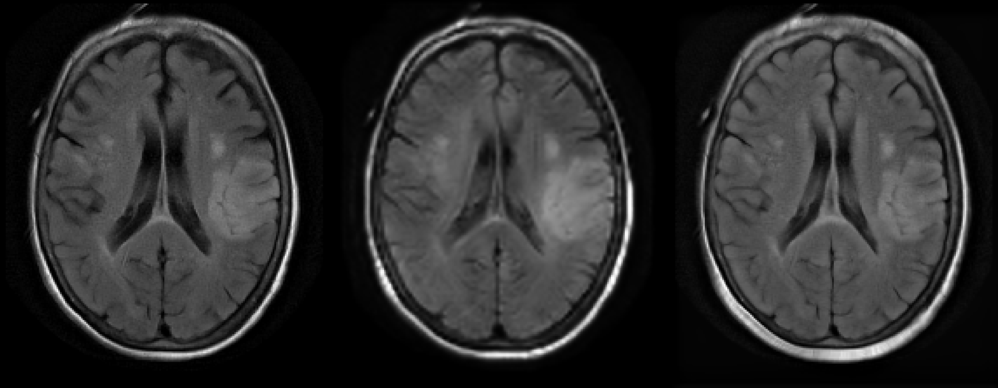
Medical Image-to-Image Translation
We focus on visualizing changes in patient attributes
Desired change in attributes
Age +20 years
Disease severity -1
Input Image
Output Image

Slide 4
Motivation
Conditional generative adversarial networks (cGANs) present a general purpose ML method
But can create artifacts, especially with small or noisy training datasets

Slide 5
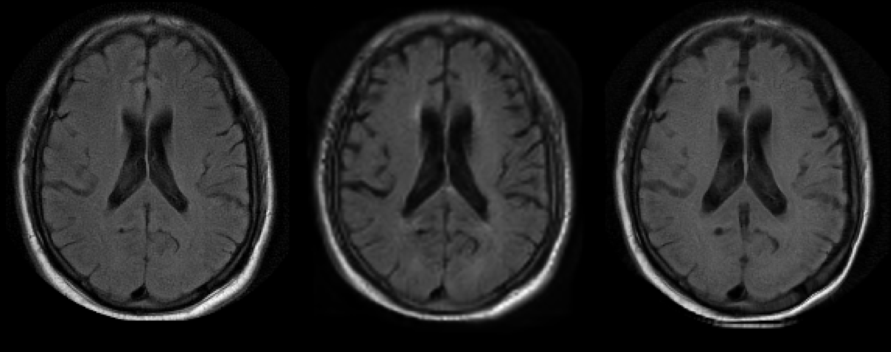
Motivation
Input Image
cGAN Output
Input Image
cGAN Output
Age Increase
(46-86)
Age Decrease
(81-51)
Can we tailor cGANs to this task and domain?

Slide 6
Previous Work
Identity-preservation loss: small changes in age should result in small changes in image intensity
Xia et al. Consistent Brain Ageing Synthesis. MICCAI 2019.
Biological constraints: incorporate prior knowledge of how intensity of anatomical regions should change with age
Ravi et al. Degenerative adversarial neuroimage nets: Generating images that mimic disease progression. MICCAI 2019.
More general priors?

Slide 7
Priors for Medical Image Translation
Morphological changes should be smooth
Intensity differences should be localized or smooth
How do we incorporate this in a conditional GAN?
Output transforms instead of an image

Slide 8
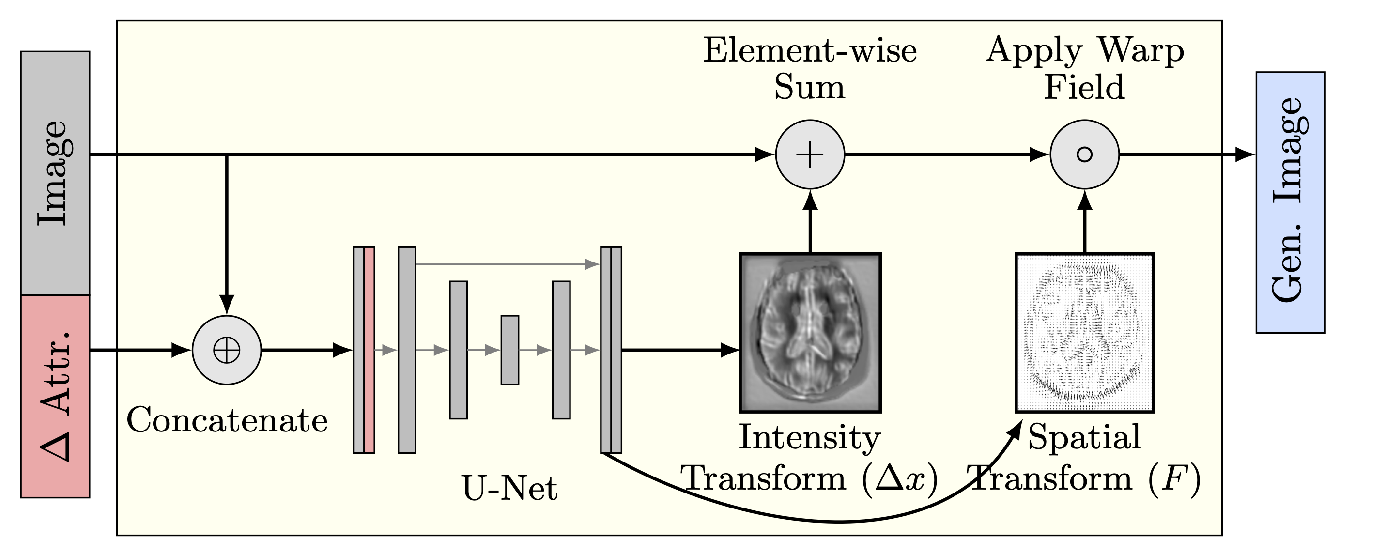
Spatial-Intensity Transform

Slide 9
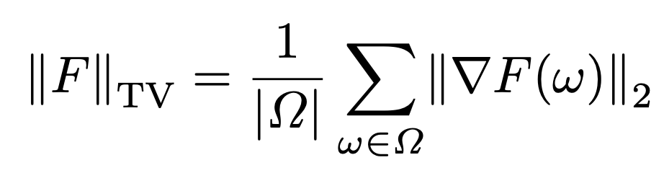
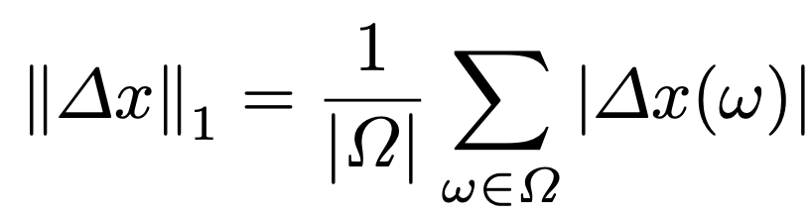
Spatial-Intensity Regularizers
Smooth deformation
Sparse intensity changes

Slide 10
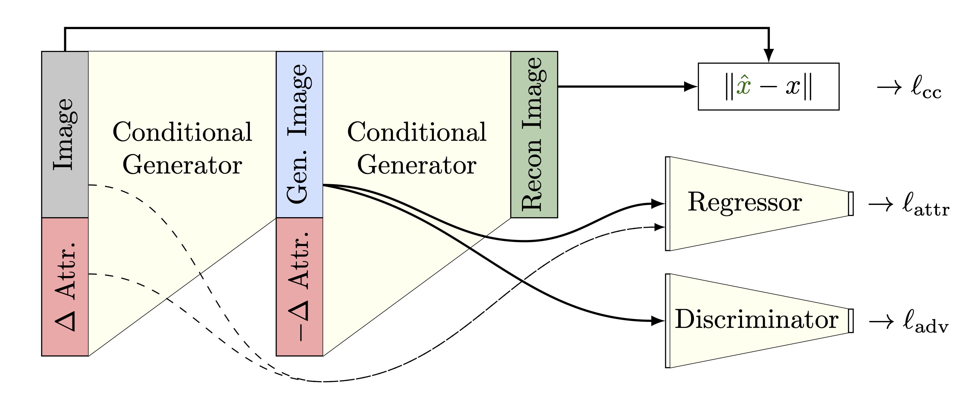
Model Training

Slide 11
Model Training
Output images should:
Be consistent with original image → cycle consistency loss

Slide 12
Model Training
Output images should:
Be consistent with original image → cycle consistency loss
Match target domain → attribute loss

Slide 13
Model Training
Output images should:
Be consistent with original image → cycle consistency loss
Match target domain → attribute loss
Appear realistic → adversarial loss

Slide 14
Experiments
MRI-GENIE study
Patients with acute ischemic stroke
12 clinical sites, 1821 axial T2 FLAIRs
Condition on age and stroke severity (partially labeled)
Tune hyperparameters with 5-fold cross-validation on 418 images from 1 site
Test on 11 other sites - all results are from testing

Slide 15
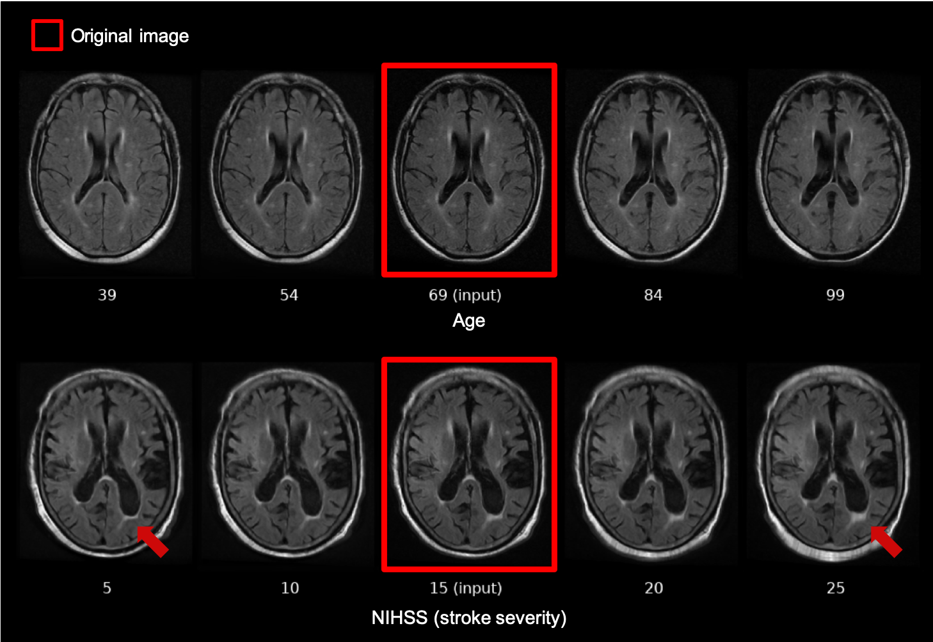
Example Outputs

Slide 16
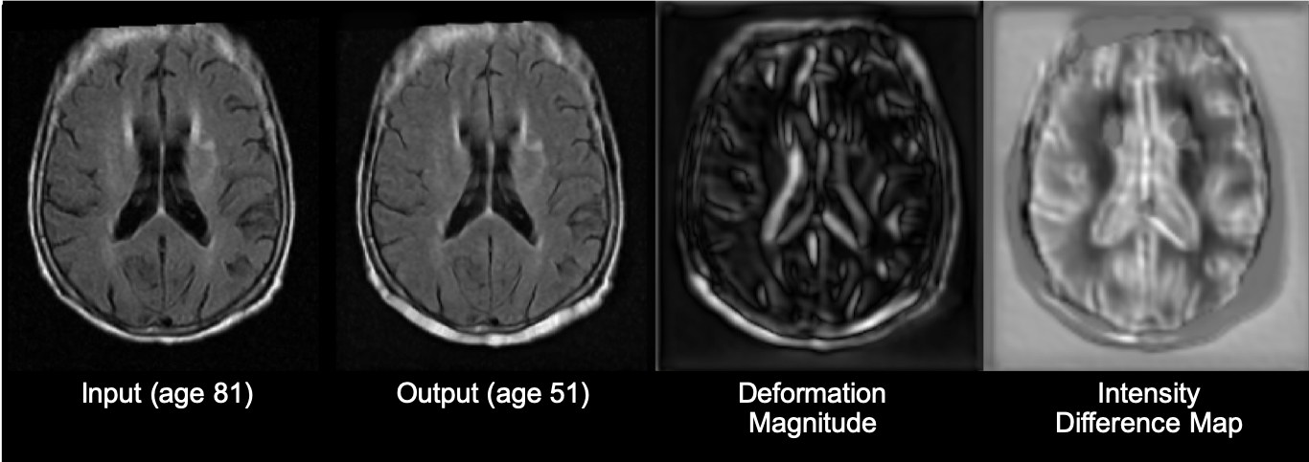
Example Output
SIT-GAN provides a disentangled view of morphological and tissue intensity changes

Slide 17
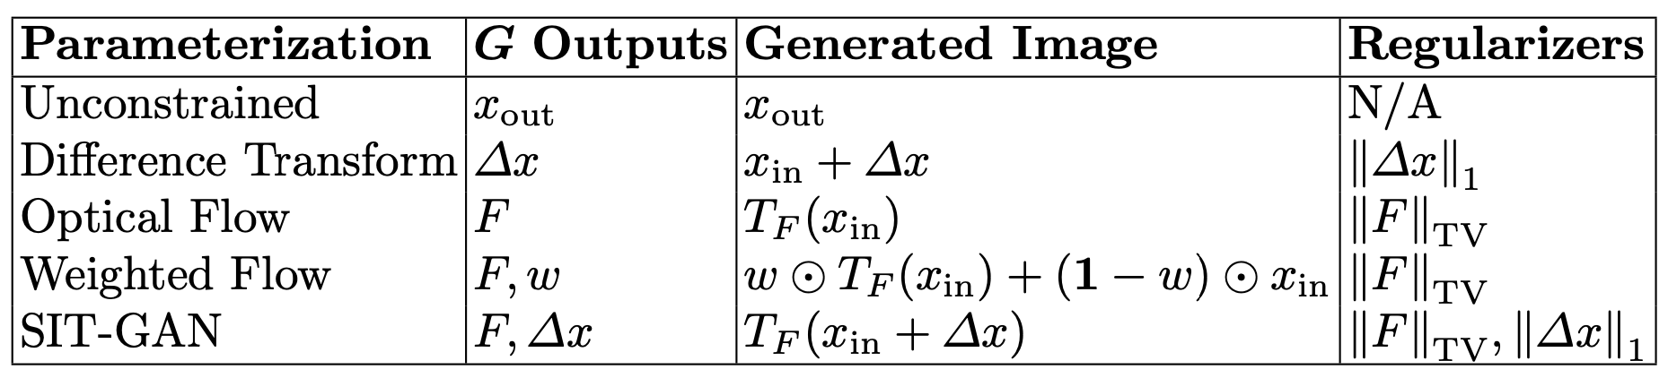
Network Comparison

Slide 18
Evaluating Model Performance
Measures of image fidelity (realism)
FID (Fréchet Inception distance)
Heusel et al. GANs trained by a two time-scale update rule converge to a local Nash equilibrium. NeurIPS 2017.
Precision and recall for distributions
Sajjadi et al. Assessing generative models via precision and recall. NeurIPS 2018.
Measure of target domain matching
MSE between desired attributes and estimated attributes
age and NIHSS

Slide 19
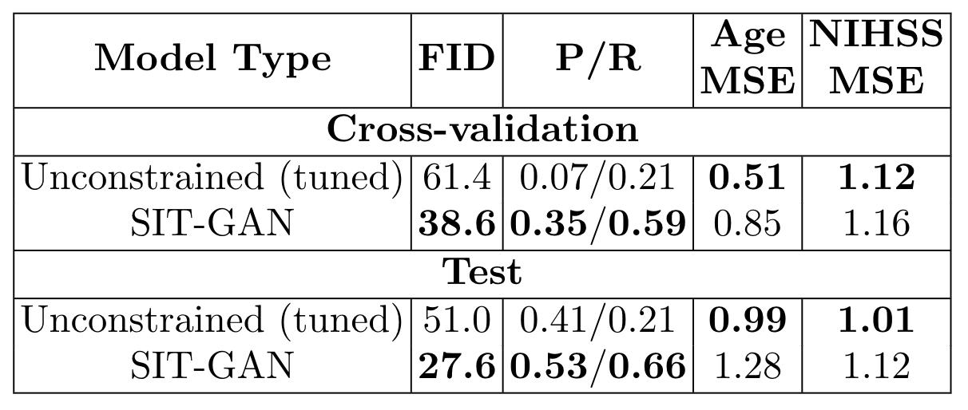
Model Performance
Spatial-intensity transforms cause a trade off between image quality and target attribute matching.

Slide 20
Example Comparison
Input Image
Unconstrained (Tuned)
SIT-GAN
SIT-GAN avoids adding partial volume-like effects
Age Decrease
(81-51)

Slide 21
Example Comparison
Input Image
Unconstrained (Tuned)
SIT-GAN
SIT-GAN avoids adding dark streaking across sulci
Age Increase
(46-86)

Slide 22
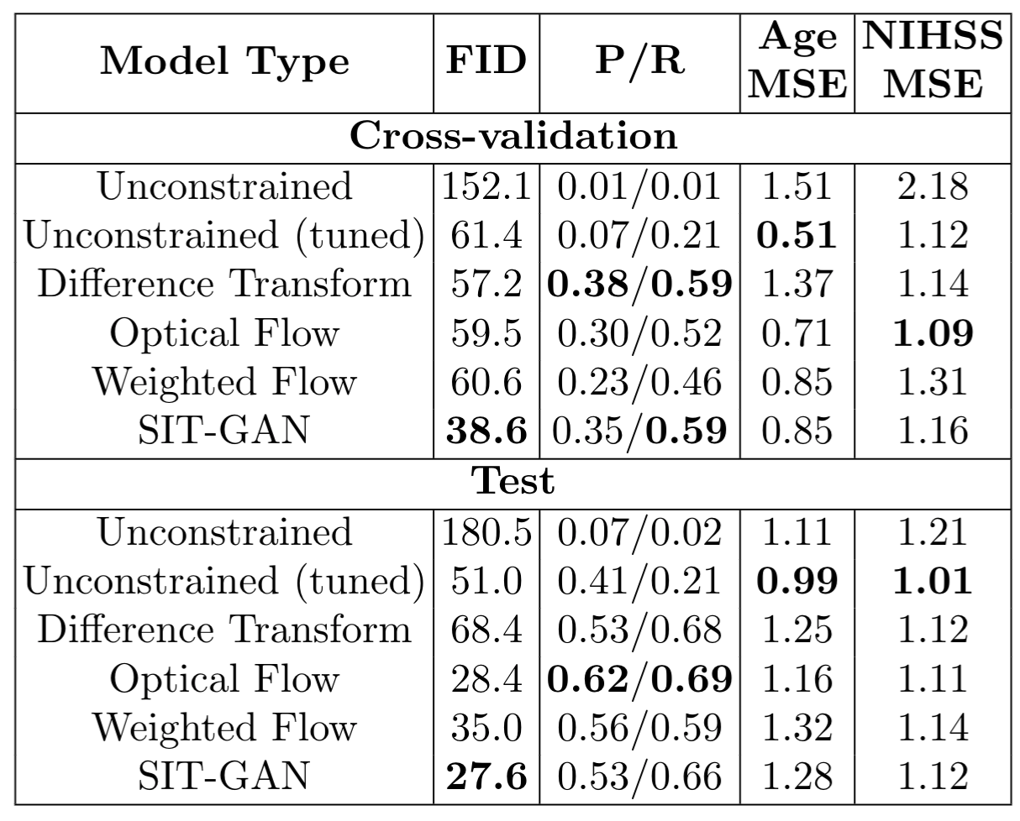
Model Performance

Slide 23
Conclusion
Spatial-intensity transforms achieve superior image fidelity in medical image-to-image translation
SIT-GAN provides a disentangled view of changes in shape and tissue appearance
Future Work
Explore the tradeoff between image fidelity and target domain matching
Extend 2D generative models to 3D
Acknowledgments
This work was supported by NIH NIBIB NAC P41EB015902, NIH NINDS U19NS115388, NIH NINDS R01NS086905, Wistron Corporation, Takeda Pharmaceuticals and the Siebel Foundation.

